Slide 1
A Clear and Practical Hybrid Deep Learning Model for Fashion Image Classification
PRESENTED BY:CHIRRABOYINA VENKATA PHANISAI
STUDENT ID:P2897818
MOUDLE NAME:ARTIFICAL NEURALNETWORKS&NLP
MODULE CODE: CSIP5103
De Montfort University

Slide 2
INTRODUCTION
Fashion-MNIST is a benchmark dataset composed of 70,000 grayscale images represented by 10 clothing categories in terms of an image classification task.
Image classification is essential to retail, e-commerce, and automated fashion-recognition systems, emphasizing their significance in real-world applications.
Traditional Artificial Neural Networks (ANN) must flatten the image vectors and hence struggle to learn spatial patterns resulting in poor accuracy with visual data.
Convolutional Neural Networks (CNN) were created for image understanding because they can extract some hierarchical spatial features like edges, textures, and shapes.
This work builds and compares two architectures, ANN and CNN models, to assess their performance, showing which architecture is superior specifically for image classification tasks using Fashion-MNIST.

Slide 3
objectives
Develop and train an ANN and a CNN model for Fashion-MNIST image classification.
We will assess model performance using accuracy, loss trends, confusion matrices, and classification metrics.
We will assess model generalization using the validation results and analysis of performance across each class.
We will assess the limitations of the model and we will examine where it tends to misclassify to determine if, and how it is limited.
We will provide some suggestions and directions for future research that can assist in maximizing overall accuracy and/or stability.

Slide 4
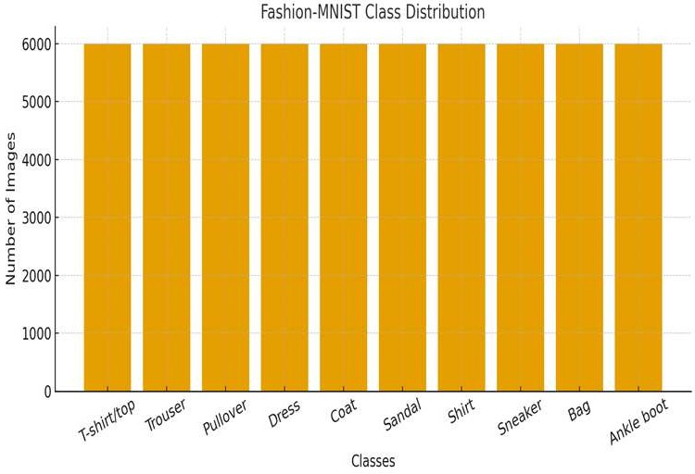
Dataset Overview
The Fashion-MNIST dataset has 70,000 grayscale images that are 28x28 pixels in size. Each image belongs to one of 10 classes of clothing - Shirt, Dress, Sneaker, Bag, etc.- and is split into training data, 60%, validation data, 20%, and testing data 20%.
There are key steps to be aware of in the preprocessing steps:
Normalization: The process of tone down the pixel values from 0 - 255 to 0 - 1. This is useful to stabilizing the training.
Reshape: Changing the shape of the images from 28x28 to flat arrays of 784 pixels for input data to the ANN.
One-hot Encoding: Changing the target labels to one-hot encoding that can be used properly to fit in the model.
Data Augmentation f you used it with your data, you can add these may be a variable here)

Slide 5
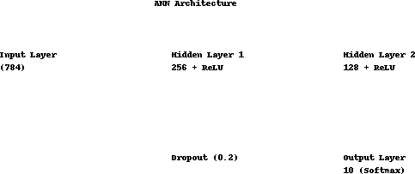
Model Design - Artificial Neural Network ANN
Architecture Summary
Input layer: 784 neurons (flattened 28×28 image)
Hidden Layer 1: 256 neurons, ReLU activation
Hidden Layer 2: 128 neurons, ReLU activation
Dropout (20%) to reduce overfitting
Output Layer: 10 neurons, Softmax activation
Training Configuration
Optimizer: Adam
Loss Function: Categorical Cross-Entropy
Learning Rate: 0.001
Epochs: 20
Batch Size: 64

Slide 6
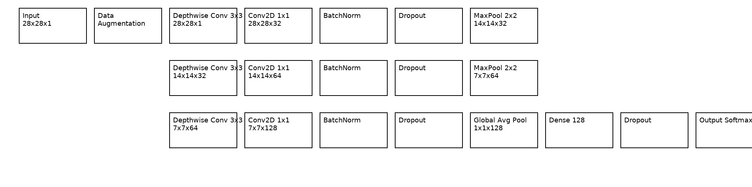
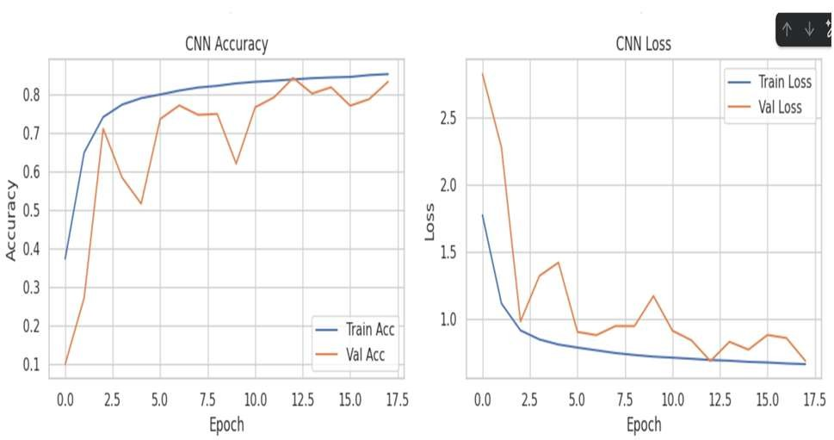
Model Design: CNN Architecture
Input: 28×28×1 grayscale images
Convolution Layers:
Conv1: 32 filters (3×3), ReLU
Conv2: 64 filters (3×3), ReLU
Pooling: Max Pooling (2×2) to reduce spatial dimensions
Regularization: Dropout to prevent overfitting
Fully Connected Layers:
Dense: 128 neurons, ReLU
Output: 10 classes, Softmax activation
Optimizer & Loss: Adam + Categorical Cross-Entropy
Why CNN is Better for Image Classification
Extracts spatial and visual patterns automatically
Learns edges, textures, shapes, and features at different levels
More accurate than ANN for image data due to local feature learning
Reduces parameters vs. ANN → more efficient for images

Slide 7
Training & Evaluation Setup
Training Configuration
The models were trained for 25 epochs with a batch size of 64 to ensure efficient learning and stable convergence.
Adam optimizer was used due to its adaptive learning capability and faster convergence.
A learning rate of 0.001 was used, along with a Learning Rate Scheduler to gradually reduce the learning rate and improve model performance.
The Categorical Cross-Entropy loss function was used as it is suitable for multi-class classification problems.
Early Stopping was implemented to prevent overfitting by stopping training when no improvement was observed.
Evaluation Strategy
Model performance was evaluated using Accuracy and Loss curves for both training and validation sets.
Confusion Matrix was used to analyze the classification performance of each class.
Precision, Recall, and F1-Score were computed to provide a detailed performance comparison.
Class-wise Performance Analysis was performed to identify strengths and misclass

Slide 8
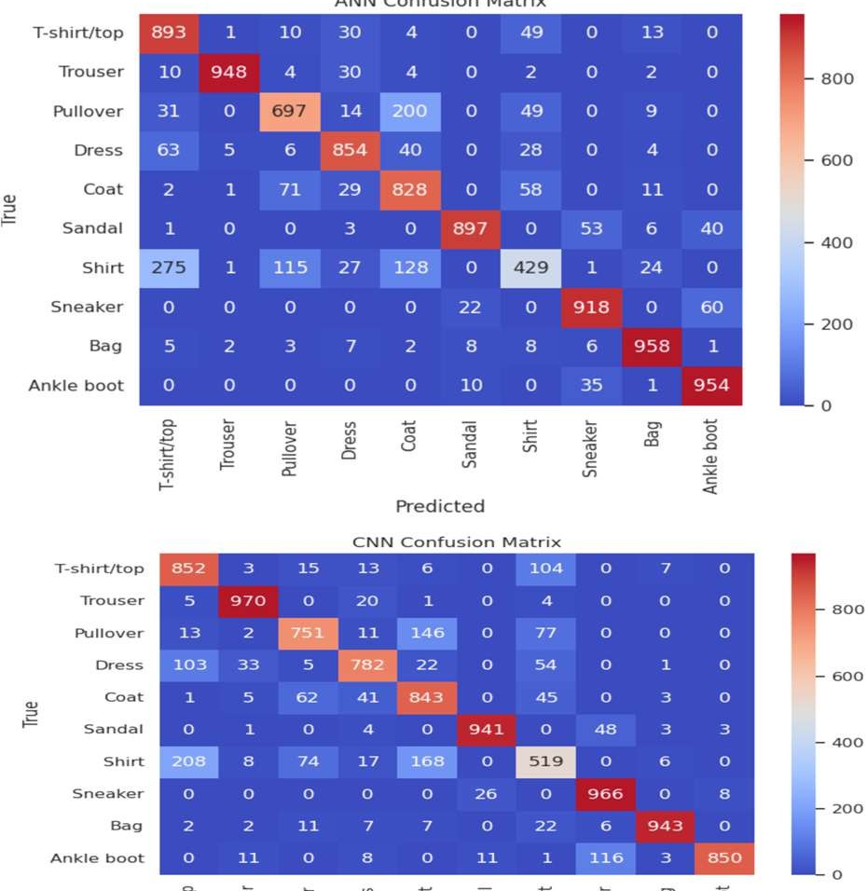
Results & Comparison (ANN vs CNN)
CNN outperformed ANN in overall accuracy, demonstrating better capability for image feature extraction.
ANN learning plateaued early, while CNN continued improving across epochs, indicating stronger learning capacity.
CNN generalizes better with lower validation loss and more stable performance over epochs.
Confusion Matrix Insights:
ANN struggled with Shirt, Pullover, and Coat classifications, showing higher misclassifications.
CNN reduced misclassification errors across most classes, especially for Sneaker, Bag, and Coat.
CNN correctly captured spatial patterns, improving prediction confidence and reducing confusion between similar clothing categories.
Key :
CNN is more effective than ANN for image-based classification tasks such as Fashion-MNIST due to its spatial feature learning capability.

Slide 9
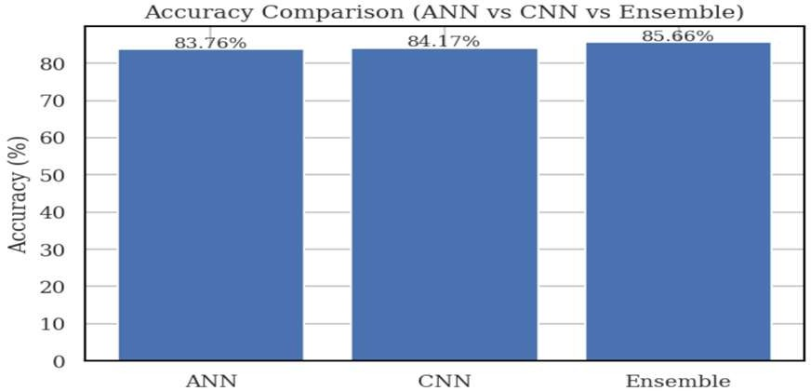
Discussion & Key Insights
CNN outperformed ANN because it learns spatial features (edges, textures, patterns) directly from images
ANN struggled due to lack of feature extraction → treats image as flat vector
Common misclassifications occurred between visually similar classes:
T-shirt/top vs Shirt
Pullover vs Coat
Ensemble model gave balanced improvement across all classes
CNN trained slower but generalized better with lower validation loss
Learned importance of:
Convolution layers for image tasks
Data preprocessing & tuning
Evaluating using more than accuracy (F1, confusion matrix)

Slide 10
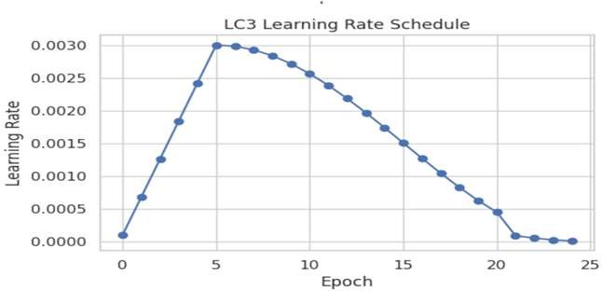
Improvements and Enhancements
Improvements Applied / Possible Enhancements
Data Augmentation (rotation, flip, shift) to reduce overfitting
Dropout & Batch Normalization for improved regularization and stable training
Learning Rate Scheduling (StepLR / Cosine Annealing / Reduce LR On Plateau) for smootherconvergence
Hyperparameter Tuning (batch size, LR, optimizer, epochs)

Slide 11
CONCLUSION& Future scope
The results of this classification showed that CNN had better performance than ANN because it was able to learn spatial characteristics better.
Evaluation also proved that it is not enough to just compare accuracy, but that we must also look at precision, recall, and F1-score for a true sense of performance.
We also improved our models using dropout, LR scheduling, and augmentation, which saw better results on our models while also reducing overfitting.
For future work, we want to try Transfer Learning, and deep CNN architecture like ResNet and MobileNet.
We could also see accuracy increases by introducing an Ensemble of multiple CNNs or maybe even a Vision Transformer.

